Slide 1
Difference between Token based and Non-Token based Algorithms in Distributed System:
S.No | Token Based Algorithms | Non-Token Based Algorithms
1. | A unique token is shared among all the sites in Distributed Computing Systems. | No token even not any concept of sharing token for access.
2. | Here, a site is allowed to enter the Computer System if it possesses the token. | Here, two or more successive rounds of messages are exchanged between sites to determine which site is to enter the Computer System next.
3. | Uses the sequences to order the request for the CS and to resolve the conflict for the simultaneous requests for the System. | Uses the timestamp to order the request for the CS and to resolve the conflict for the simultaneous requests for the System.
4. | Produces less message traffic as compared to Non-Token based Algorithm. | Produces more message traffic as compared to the Token-based Algorithm.
5. | They are free from deadlock (i.e. here there are no two or more processes are in the queue in order to wait for messages that will actually can’t come) because of the existence of unique token in the distributed system. | They are not free from the deadlock problem as they are based on timestamp only.
6. | Here, it was ensured that requests are executed exactly in the order as they are made in. | Here there is no surety of execution order.
7. | More scalable as they can free our server from having to store session state and also they contain all the necessary information which they need for authentication. | Less scalable than the Token-based algorithms because here server is not free from its tasks.
8. | Here the access control is quite Fine-grained because here inside the token roles, permissions and resources can be easily specifying for the user. | Here the access control is not so fine as there is no token which can specify roles, permission, and resources for the user.
9. | Token-based algorithms make authentication quite easy. | Non-Token based algorithms can’t make authentication easy.
10. | Examples of Token-Based Algorithms are: (i) Singhal’s Heuristic Algorithm (ii) Raymonds Tree Based Algorithm (iii) Suzuki-Kasami Algorithm | Examples of Non-Token Based Algorithms are:(i) Lamport’s Algorithm (ii) Ricart-Agarwala Algorithm (iii) Maekawa’s Algorithm

Slide 2
Token Based Algorithms
Suzuki-Kasami Algorithm
Raymonds Tree Based Algorithm
Singhal's Heuristic Algorithm

Slide 3
(A) Suzuki–Kasami algorithm
is a token-based algorithm for achieving mutual exclusion in distributed systems.This is modification of Ricart–Agrawala algorithm, a permission based (Non-token based) algorithm which uses REQUEST and REPLY messages to ensure mutual exclusion.
In token-based algorithms, A site is allowed to enter its critical section if it possesses the unique token. Non-token based algorithms uses timestamp to order requests for the critical section where as sequence number is used in token based algorithms.
Each requests for critical section contains a sequence number. This sequence number is used to distinguish old and current requests.
Site with max/highest seq no will allowed to enter CS.

Slide 4
Data structure and Notations:
An array of integers RN[1…N]
A site Si keeps RNi[1…N], where RNi[j] is the largest sequence number received so far through REQUEST message from site Si.
An array of integer LN[1…N]
This array is used by the token.LN[J] is the sequence number of the request that is recently executed by site Sj.
A queue Q
This data structure is used by the token to keep record of ID of sites waiting for the token

Slide 5
Algorithm:
To enter Critical section:
When a site Si wants to enter the critical section and it does not have the token then it increments its sequence number RNi[i] and sends a request message REQUEST(i, sn) to all other sites in order to request the token.
Here sn is update value of RNi[i]
When a site Sj receives the request message REQUEST(i, sn) from site Si, it sets RNj[i] to maximum of RNj[i] and sn i.e RNj[i] = max(RNj[i], sn).
After updating RNj[i], Site Sj sends the token to site Si if it has token and RNj[i] = LN[i] + 1
To execute the critical section:
Site Si executes the critical section if it has acquired the token.
To release the critical section:
After finishing the execution Site Si exits the critical section and does following:
sets LN[i] = RNi[i] to indicate that its critical section request RNi[i] has been executed
For every site Sj, whose ID is not present in the token queue Q, it appends its ID to Q if RNi[j] = LN[j] + 1 to indicate that site Sj has an outstanding request.
After above updation, if the Queue Q is non-empty, it pops a site ID from the Q and sends the token to site indicated by popped ID.
If the queue Q is empty, it keeps the token

Slide 6
Message Complexity:
The algorithm requires 0 message invocation if the site already holds the idle token at the time of critical section request or maximum of N message per critical section execution. This N messages involves
(N – 1) request messages
1 reply message
Drawbacks of Suzuki–Kasami Algorithm:
Non-symmetric Algorithm: A site retains the token even if it does not have requested for critical section.
According to definition of symmetric algorithm “No site possesses the right to access its critical section when it has not been requested.”
Performance:
Synchronization delay is 0 and no message is needed if the site holds the idle token at the time of its request.
In case site does not holds the idle token, the maximum synchronization delay is equal to maximum message transmission time and a maximum of N message is required per critical section invocation.

Slide 7
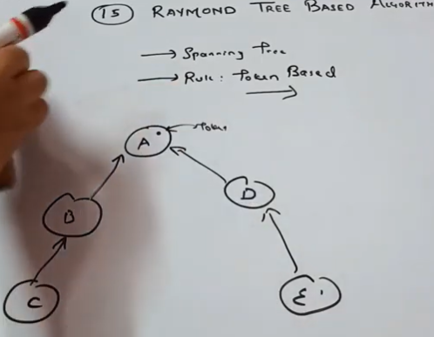
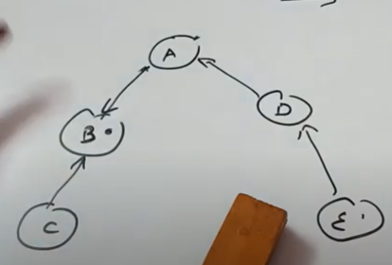
(B) Raymonds Tree Based Algorithm
Raymond’s tree based algorithm is lock based algorithm for mutual exclusion in a distributed system in which a site is allowed to enter the critical section if it has the token. In this algorithm, all sites are arranged as a directed tree such that the edges of the tree are assigned direction towards the site that holds the token. Site which holds the token is also called root of the tree.
Data structure and Notations:
Every site Si keeps a FIFO queue, called request_q
This queue stores the requests of all neighbouring sites that have sent a request for the token to site Si but have not yet been sent token. A non-empty request_q at any site indicates that the site has sent a REQUEST message to the root node.
Every site Si has a local variable, called holder
This variable points to an immediate neighbour node on a directed path to the root node.

Slide 8
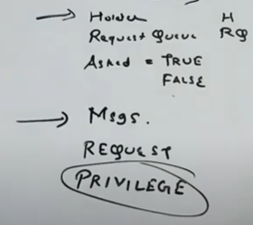
Initials of Data Structure used
Holder: used to identify which site belong to which one, eg. In figure below holder of D is B.
Asked can be true or false. Ie, any site is requesting or not . True means the site is requesting.
Messages: 2 msgs are used- request and priviledge
Priviledge: here prviledge is used when one site allow other site to take token. Used in place of Reply(eg: in Ricart agarwala etc)
For initial stage, the data structure will work as:
Holder(H) of each site is identified. But the holder of root is nobody so denoted by :self.
Initially all request Queue(RQ) is empty(e).
As no site is currently requesting for token, so Asked will be F.
These 3 data structure will work for all sites but for the root(where there is token), there will be only 2 data structure. It will not require “Asked” as it is already holding a token.

Slide 9
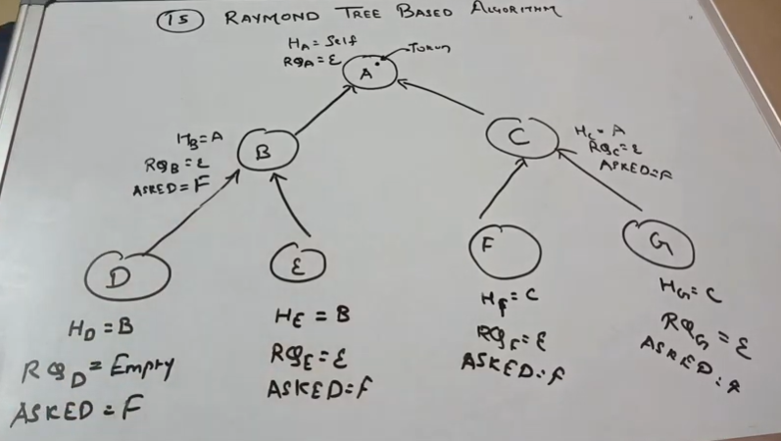
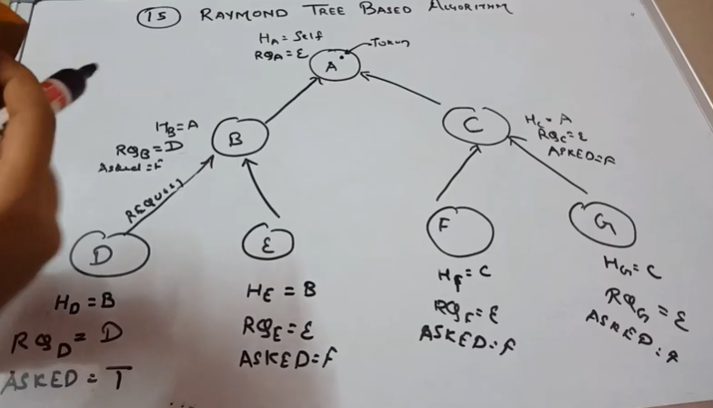
For initial stage(1):
(2) Now, site D is requesting for token. Its data structure will get changed. This request will continue to move forward till it get that site whose Holder is self because this denotes that our request has reached to that site which possess or contain the token.

Slide 10
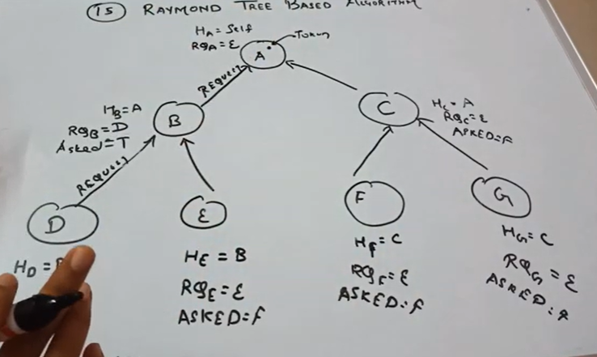
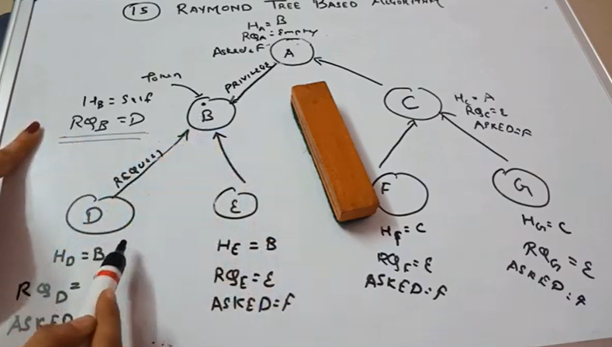
(3) Requset moves till reached Holder=self. Here it stops moving forward.
Now, site A will remove its token and on the basis of request from site B, it will give privilege to B and point towards B. Holder of B will be now “self” as it contain token now. Holder of A will be now B, A’s RQ will be empty and Asked will be “F” as it is not asking for token. B will have now only 2 data structure as it have token.
Request is still pending for D, so B which have token will give priviledge to D( see in next figure)

Slide 11
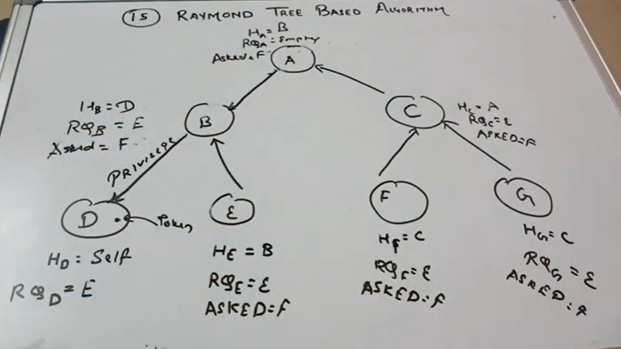
(6) As initial request is made by D , so B will give privilege to D, will point to D and change will occur in the data structure. Holder of B will be D, its RQ will be empty, Asked will be F and the token will be transferred to D.
Now, the Holder of D will be “Self” as it was the site which made request initially. Its RQ will be empty. It will not have “Asked” as it is not reqeusting any more; already got the token.

Slide 12
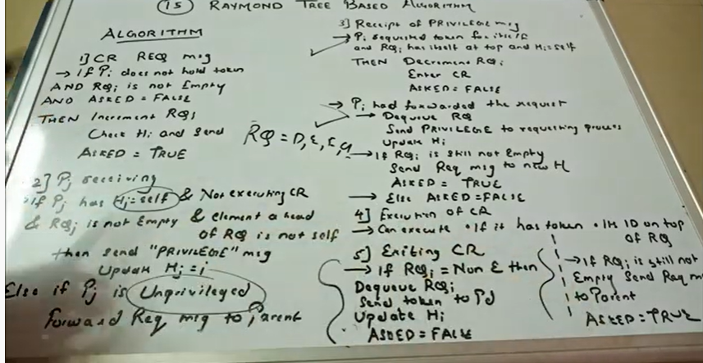

Slide 13
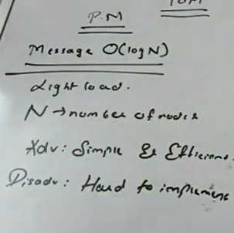
Performance Metrix

Slide 14
Algorithm:
a) To enter Critical section:
When a site Si wants to enter the critical section it sends a REQUEST message to the node along the directed path to the root, provided it does not hold the token and its request_q is empty. After sending REQUEST message it add its request to its request_q.
when a site Sj on the path to the root receives the REQUEST message of site Si, it places the REQUEST in its request_q and sends the REQUEST message along the directed path to the root, if it has not sent any REQUEST message for previously received REQUEST message.
When the root site Sr( having token) receives the REQUEST message, it sends the token to the requesting site and sets its holder variable to point at that site.
On receiving the token, Site Sj deletes the top entry from its request_q and sends the token to the site indicated by deleted entry. holder variable of Site Sj is set to point at that site. After deleting the topmost entry of the request_q, if it is still non-empty Site Sj sends a REQUEST message to the site indicated by holder variable in order to get token back.

Slide 15
b) To execute the critical section:
Site Si executes the critical section if it has received the token and its own entry is at the top of its request_q.
c) To release the critical section:
After finishing the execution of the critical section, site Si does the following:
If its request_q is non-empty, then it deletes the top msot entry from its <request_q and then it sends the token to that site indicated by deleted entry and also its holder variable is set to point at that site.
After performing above action, if the request_q is still non-empty, then site Si sends a REQUEST message to the site pointed by holder variable in order to get token back
Message Complexity:
In the worst case, the algorithm requires 2 * ( Longest path length of the tree ) message invocation per critical section entry. If all nodes are arranged in a straight line then the longest path length will be N – 1 and thus the algorithm will require 2 * (N -1) message invocation for critical section entry. However, if all nodes generates equal number of REQUEST messages for the privilege, the algorithm will require approximately 2*N / 3 messages per critical section entry.

Slide 16
Drawbacks of Raymond’s tree based algorithm:
can cause starvation: Raymond’s algorithm uses greedy strategy as a site can executes the critical section on receiving the token even when its request is not on the top of the request queue. This affect the fairness of the algorithm and thus can cause in starvation.
Performance:
Synchronization delay is (T * log N )/ 2, because the average distance between two sites to successively execute the critical section is (Log N)/2. Here T is maximum message transmission time.
In heavy load conditions, the synchronization delay become T because a site executes the critical section every time the token is transferred.
The message complexity of this algorithm is O(log N) as the average distance between any two nodes in a tree with N nodes is log N
Deadlock is impossible

Slide 17
(C ) Singhal's Heuristic Algorithm
Almost similar to Suzuki Kasami(follows the same method), but aims to remove the disadvantages of Suzuki Kasami.
Suzuki kasami has lot of message overhead. Almost need N messages to request the token.
To reduce the overhead, it work as:
For requesting process it is not needed to give messages to all other processes. Only give to those processes who have the highest probability of having the token.
But how the process will come to know this????
This can be possible with the help of “Heuritic”, ie. Process must have the knowledge of the state of the processes.
There are 4 states:
(E): Executing and holding token
(H): Holding token and not executing
(R): Requesting token
(N): Neutral
It should be noted that to avoid deadlock and starvation, the requesting process(here P1) must send request to those processes who are in the state as : H , E and R

Slide 18
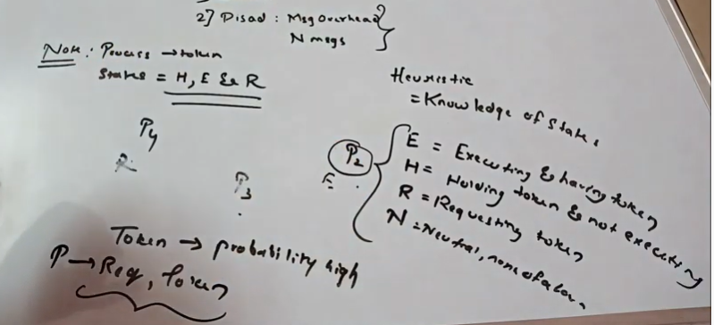
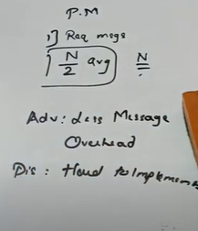
Performance metrix:
Avearge : N/2
Worst case: N

